Slide 1
Leverage the Microsoft Graph & 3rd Party APIs
Calling the Microsoft Graph

Slide 2

Calling the Microsoft Graph
Overview of the Microsoft Graph
Microsoft Graph JavaScript API
TypeScript Type Declarations
SPFx’s MSGraphClient

Slide 3
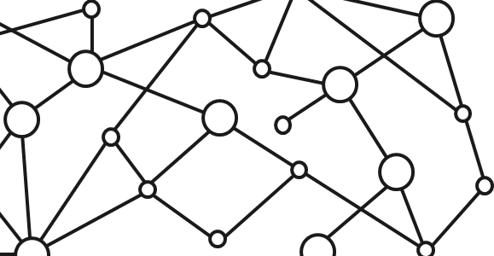
Microsoft 365 Platform
Extend Microsoft 365 experiences
web, device, and service apps
Build your experience
Documents
Pages
Conversations
Timeline
iOS/Android/Windows/Web
1
Microsoft Graph
Notes:
Our Office 365 developer vision focuses on the Users’ experience and their data. As a developer you can bring your applications into their user experience. With over 1.2+ billion users of Office Worldwide, this is a huge opportunity to provide a window into your applications. As well as being able to connect into their data and add intelligence to your applications. There are currently 850 million events created a month and a total of 470Pb+ of data stored in the service that can add value to for our Users’.

Slide 4

Microsoft Graph Gateway to your data in the Microsoft-cloud
https://graph.microsoft.com
Office 365
Windows 10
Enterprise Mobility + Security
Users, Groups, Organizations
Outlook
SharePoint
OneDrive
Teams
Planner
Excel
OneNote
Activities
Device Relay
Commands
Notifications
Azure AD
Intune
Identity Manager
Advanced Threat Analytics
Advanced Threat Protection
Mail, Calendar,
Contacts and Tasks
Sites and Lists
Drives and Files
Channels, Messages
Tasks and Plans
Spreadsheets
Notes, and more…
Identity Management
Access Control
Synchronization
Domains
Administrative Units
Applications and Devices
Advanced Threat Analytics
Advanced Threat Protection
Alerts
Policies
and more…

Slide 5
Microsoft Graph, gateway to Office 365
Single resource that proxies multiple Microsoft services
Allows for easy traversal of objects and relationships
Simplifies token acquisition and management
Eliminates the need to traditional discovery (using “me” and “myorganization”)

Slide 6
Microsoft Graph JavaScript SDK
Microsoft Graph is accessible via REST API & various SDKs
Client-side solutions can leverage the JavaScript SDK
https://github.com/microsoftgraph/msgraph-sdk-javascript
Requires initialization with an Azure AD provided OAuth2 access token to create the client
Notes:
Let’s review from the previous section

Slide 7
Initializing the Microsoft Graph JS SDK
var client = MicrosoftGraph.Client.init({
authProvider: (done) => {
done(null, access_token);
}
});
client
.api('/me')
.get((err, res) => {
console.log(res);
});

Slide 8
Microsoft Graph TypeScript Type Declarations
Use the Microsoft Graph JavaScript SDK in TypeScript applications
TypeScript type declarations introduce strong types and documentation to client-side projects
https://github.com/microsoftgraph/msgraph-typescript-typings

Slide 9
Microsoft Graph TypeScript Type Declarations
import * as MicrosoftGraph from '@microsoft/microsoft-graph-types';
// init Microsoft Graph client
client
.api('/me')
.get((error: any, user: MicrosoftGraph.User, rawResponse?: any) => {
console.log('name: ', user.displayName);
console.log('email: ', user.mail);
console.log('phone: ', user.businessPhones[0]);
});
});

Slide 10
SharePoint Framework Includes a Microsoft Graph Client
MSGraphClient: SharePoint Framework’s Microsoft Graph Client
Abstracts the token acquisition from the SharePoint Framework’s support for Azure AD
Wraps the Microsoft Graph JavaScript SDK and initializes it with one line that returns a promise
this.context.msGraphClientFactory
.getClient()
.then((client: MSGraphClient): void => {
// use MSGraphClient here
});

Slide 11
SPFx Solutions Declare Permission Requests
// package-solution.json
{
"$schema": "https://developer.microsoft.com/json-schemas/spfx-build/package-solution.schema.json",
"solution": {
"name": "ms-graph-sp-fx-client-side-solution",
"id": "dfb230b7-4f61-431f-9b65-a34e83922663",
"version": "1.0.0.0",
"includeClientSideAssets": true,
"webApiPermissionRequests": [
{ "resource": "Microsoft Graph", "scope": "User.ReadBasic.All” },
{ "resource": "Microsoft Graph", "scope": "Calendars.Read” },
{ "resource": "Microsoft Graph", "scope": "Tasks.Read” }
]
},
"paths": {
"zippedPackage": "solution/ms-graph-sp-fx.sppkg"
}
}

Slide 12
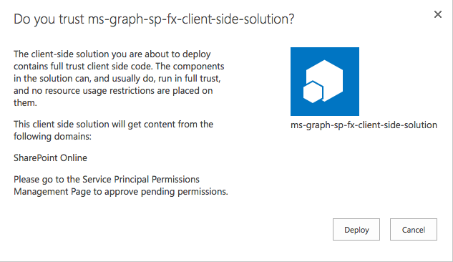
Add SharePoint Package to SharePoint App Catalog
Upload SharePoint packages to the app catalog
Extra note in dialog notifies of additional step required
While application can be installed in SharePoint sites, it does not have the permissions granted that it needs to access Azure AD protected resources

Slide 13
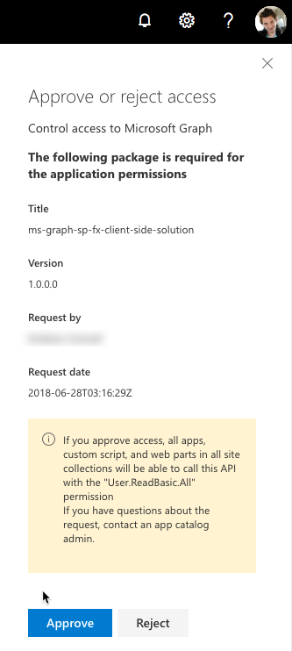
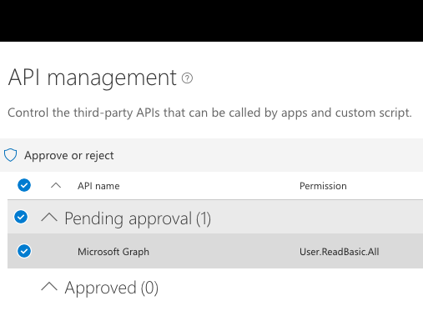
Approve / Reject with SharePoint Online API Management Page

Slide 14
Demo Calling the Microsoft Graph

Slide 15

Summary
Overview of the Microsoft Graph
Microsoft Graph JavaScript API
TypeScript Type Declarations
SPFx’s MSGraphClient

Slide 16
Reading further
Overview of the SharePoint Framework
https://docs.microsoft.com/en-us/sharepoint/dev/spfx/sharepoint-framework-overview
Use the MSGraphClient to Connect to Microsoft Graph
https://docs.microsoft.com/sharepoint/dev/spfx/use-msgraph

Slide 17
Thank you.

